Slide 1
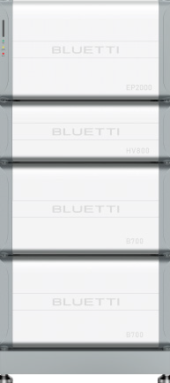
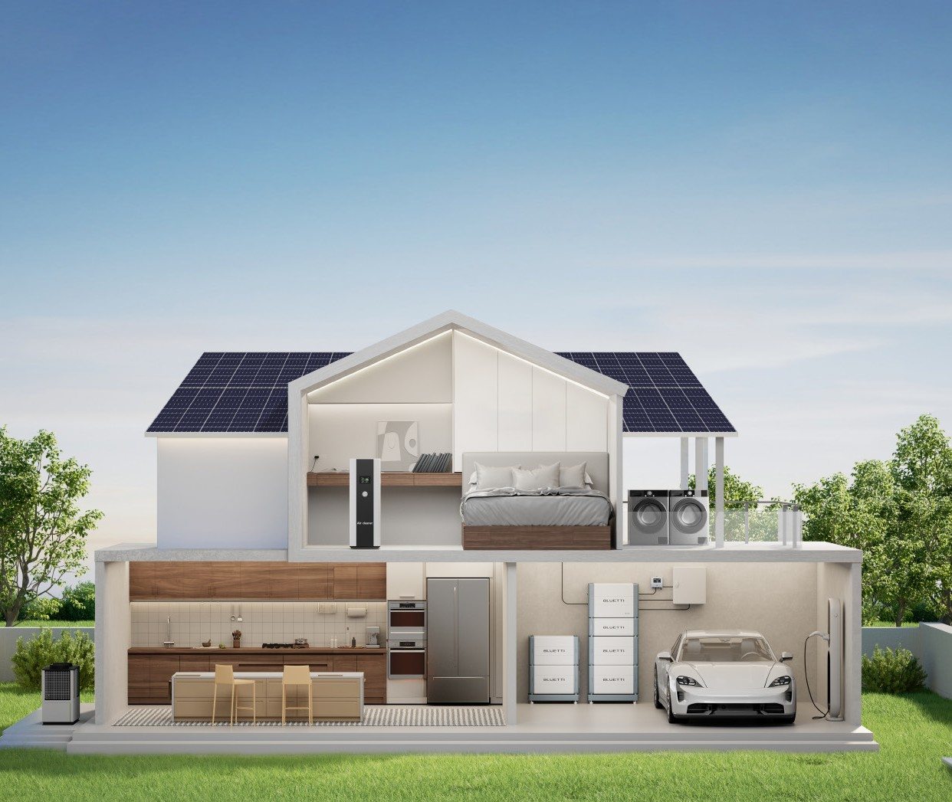
EP2000
Hybrid Inverter
EP2000
Whole-House ESS
Accelerate home energy transition with ease.
HV800
Battery Controller
B700
Expansion Battery
B700
Expansion Battery
Why Choose BLUETTI EP2000 ESS
Higher ROI
Achieve 100% energy self-sufficiency with up to 20 kW power output and 30 kW PV input. Invest one BLUETTI ESS, and get the same returns that require two units from other brands.
Up to 97.6% Efficiency: The high voltage system ensures an impressive inverter efficiency, maximizing energy conversion and reducing waste.
EP2000 and B700 energy storage system is BLUETTI's latest powerhouse integrating a hybrid solar inverter with a high-capacity energy storage battery. This all-in-one solution is tailor-made for villas, large standalone houses, small businesses, farms, and other high-power-demand situations.
With an outstanding 20 kW AC output and a 30 kW PV input, the EP2000 ESS maximizes solar energy utilization, effortlessly powering whole-house appliances, including EV and heat pumps.
Enjoy unrivaled energy independence and significant savings on electricity bills with minimal upfront investment.
More Powerful & Flexible Energy Solution
Power whole house with 10.5 kW / 15.5 kW / 20 kW optional output power and 14.7 kWh-51.6 kWh expandable capacity.
Parallel connection with up to 3 EP2000 units for max. 60 kW output and
154.8 kWh capacity. Customize based on residential or commercial needs without paying for unnecessary capacity.
One Powers All
Time-Saving & Hassle-Free
All-in-One: Combines a hybrid solar inverter and energy storage system for seamless operation and stability.
Modular: Easy to expand, transport, and install with a plug-and-play feature, enhancing installation efficiency by 50% compared to the previous generation.
EP2000 & B700
Whole-House ESS
Secure Home Power, Save on Bills
10Years
1,900W
Washing Machine
Universal Compatibility
Whether you have an existing solar rooftop or plan to install a new one, the EP2000 ESS offers excellent compatibility to integrate with any setup.
Warranty
3,500W
Oven
11,000W
Wallbox
More Features
10−Year Warranty
Smart App Control
10.5 kW-20 kW | 14.7 kWh-51.6 kWh | Three-Phase | On-Grid / Off-Grid
2,500W
Heat Pump
Safest LFP Batteries
Seamless Backup Switch in 10ms
Elegant Appearance IP65 Protection Rating
1,000W
Refrigeration

Slide 2
Power for Every Scenario
4 APP Working Modes
Power Intelligence at Your Fingertips
1 x EP2000 + HV800 + 2 x B700
1 x EP2000 + HV800 + 4 x B700
813.8 mm
EP2000 Inverter + HV800 Battery Controller | B700 | Rated Output Power / kW (on / off grid) | Rated Output (With PV input ) | Capacity / kWh
1 | 2 | 10.5 | 20 | 14.7
 | 3 | 15.5 | 20 | 22.1
 | 4 | 20 | 20 | 29.49
 | 5 |  |  | 36.86
 | 6 |  |  | 44.2
 | 7 |  |  | 51.6
2* | 4−14 | 40 Max. | 40 Max. | 103.2 Max.
3* | 6−21 | 60 Max. | 60 Max. | 154.8 Max.
460 mm
EP2000
EP2000
24/7
HV800
249 mm
HV800
1,611.4 mm
Self-Consumption
Perfect for sunny areas with high electricity costs.
Backup
Providing uninterrupted power supply for areas with unreliable grids.
Time of Use
Great for stable grids with big price differences between peak and
off-peak times.
Custom Mode
Get tailored solutions with the BLUETTI app.
386 mm
386 mm
B700
B700
B700
386 mm
386 mm
B700
B700
B700
670 mm
670 mm
670 mm
*The parallel connection is expected to be available in Q4 2024.
How it Works
One EP2000 ESS for Whole-House Usage
EP2000 Hybrid Inverter
General
Operating Temperature
-20°C to 60°C
Warranty
10 Years
Noise
≤50dB
Dimensions (L x W x H)
670 mm × 280 mm × 460 mm
Net Weight
60 kg
Input Frequency
50 Hz
Standalone House
Villa
EMS
WiFi/Bluetooth
Cooling
Forced Air Cooling
Switch Over Time to Backup Power
<10 ms
AC PDU
Connectivity
USB / Wi-Fi / Bluetooth
Grid
M1
Protection Rating IP65
Input Apparent Power (Bypass + Charging) 40 kVA Max.
Phase
3L / N / PE
Solar panels
Total 30 kW, 4 string
EP2000
Backup
Meter Grid
PV INPUT
AC OUTPUT (BACKUP)
HV800
Transfer switch
Power
30 kW Max.
Rated Power
10.5 kW with 2 B700
15.5 kW with 3 B700
20 kW with 4−7 B700
BLUETTI app
AC Breakers (RCD)
M2 Optional (AC Coupling)
MPPT Voltage Range / Rated Voltage
160 V-850 V / 500 V
MPPT Channel / Strings per MPPT
2 / 2
Rated Output (With PV input )
20KW
B700
Single MPPT Input Current
15 A
Rated Voltage
230 / 400 VAC
Tailor with 2 to 7 B700 batteries for whole-house backup and self-sufficiency.
option
option
Existing Inverter
Solar panels
Single MPPT Short Circuit Current
20 A
Frequency
50 Hz
VOC of Solar Strings
250V~1,000V
B700
Essential loads EV Charger
Normal loads
Heat pump
Compliances
Germany: VDE-AR-N 4105:2018, DIN VDE V0124−100:2020, Austria: TOR Erzeuger Type A version 1.2, 18 April 2022
Australia: AS / NZS 4777.2:2020 Amd 1:2021
Grid Connections**
Safety
IEC 62109−1, IEC 62109−2,
EN 62109−1, EN 62109−2
RoHS 2011 / 65/EU and (EU) 2015/863
Emissions EN/IEC 61000−6−3, EN/IEC 61000−6−1
Parallel Connection for Small Businesses
HV800 Voltage Controller
General
Small Business
Farm
Combine 2/3 EP2000 ESS in parallel to boost overall capacity, output power, and PV input.
EMS WiFi/Bluetooth
Expandability
2−7 B700 Batteries
Dimensions (L x W x H)
670 mm × 280 mm × 249 mm
Grid Backup
Solar panels
Voltage Range
130 V-800 V
Noise
<25dB
EP2000
Max. Current
70 A Max.
Warranty
10 Years
M
HV800
EP2000 + HV800 + 2~7 x B700
battery packs
Net Weight
19 kg
Grid
AC PDU
B700
Compliances
Grid
B700
Safety
IEC 62619, EN 62619,
VDE-AR-E 2510−50, UN38.3
Emissions
EN/IEC 61000−6−3, EN/IEC 61000−6−1
Backup
EP2000
RoHS
2011/65/EU and (EU) 2015/863
HV800
B700 Battery
General
B700
option
option
Grid
B700
Compliances
Backup
EP2000
Battery Chemistry
LiFePO₄
Same as HV800
HV800
Capacity
7,372.8Wh
** Specifications subject
to change without further notice.
Essential loads EV Charger Normal loads Heat pump
B700
Protection Grade
IP65
EU-EN-V1.2
B700
Net Weight
72kg
Dimensions
670 mm×280 mm×386 mm
Contact Us

